Slide 1
Object Oriented Programming II (Java)
CSE - 2101
Course Group Address:
https://classroom.google.com/c/MTQ1NTI5Mjk2NjEz?cjc=ro6o2ms
Text Book:
Deitel and Deitel: Java How to Program, 9th Edition
Herber Schildt: Java2 ; The Complete Reference, 8th Edition
Ivor Horton: Beginning Java; 7th Edition

Slide 2
Course Outline
Classes : 30
Lab: Object Oriented Programming with Java
Class Participation: 10 Marks
In course : 20 Marks (2-each of 20 Marks)
Final exam : 70 Marks (5 out of 8)

Slide 3
Overview of the Syllabus
Classes and Objects
Data types, variables, operator, control structure
Inheritance
Polymorphism
Exception
Socket Programming
Applet
Thread
Input Output
Graphics/swing

Slide 4
CSE2101 – Object Oriented Programming
What is OOP
Overview of Java
Versions of Java
Java API
Create, Compile and Run a Java Program
Homework

Slide 5
Programming Languages
Three types of programming languages
  Machine languages
    Strings of numbers giving machine specific instructions
    Example:
        +1300042774
        +1400593419
        +1200274027
  Assembly languages
    English-like abbreviations representing elementary computer operations (translated via assemblers)
      Example:
        LOAD BASEPAY
        ADD OVERPAY
        STORE GROSSPAY
  High-level languages
    Codes similar to everyday English
    Use mathematical notations (translated via compilers)
    Example: grossPay = basePay + overTimePay

Slide 6
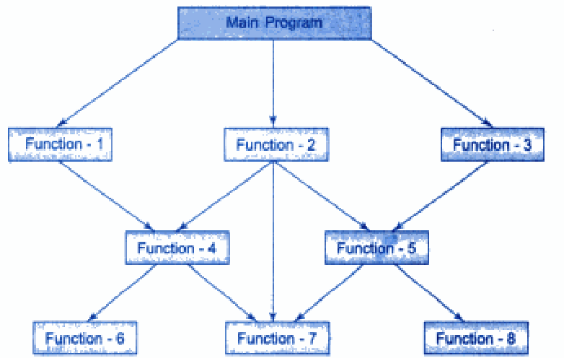
Structure/Procedure Oriented Programming
C, COBOL, FORTAN are known as Procedure Oriented Programming (POP) language.
In POP the problem is viewed as a sequence of things to be done such as reading, calculating and printing.
A number of functions are used to accomplish the task.

Slide 7
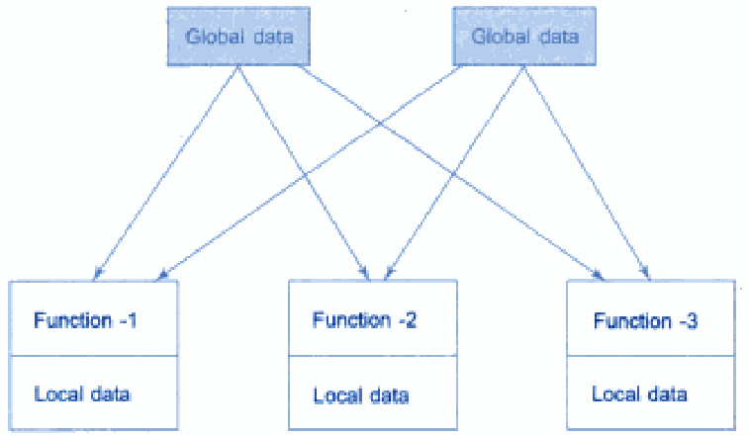
Relationship between Data and Functions in POP

Slide 8
Characteristics of POP
Emphasis is on doing things (Algorithms).
Large programs are divided into smaller programs known as Functions.
Most of the functions share Global data.
Data move openly around the system from function to function.
Functions transform data from one form to another.
Employes top-down approach in program design.

Slide 9
Object Oriented Programming
Emphasis is on Data rather than procedure.
Programs are divided into Objects.
Data structure are designed such that they characterize the objects.
Function that operate on the data of an object are tied together in the data structure.
Data is hidden and can not be accessed by external functions.
Objects may communicate with each other through functions.
New data and functions can be added whenever necessary.
Folows the bottom-up approach in program design.

Slide 10
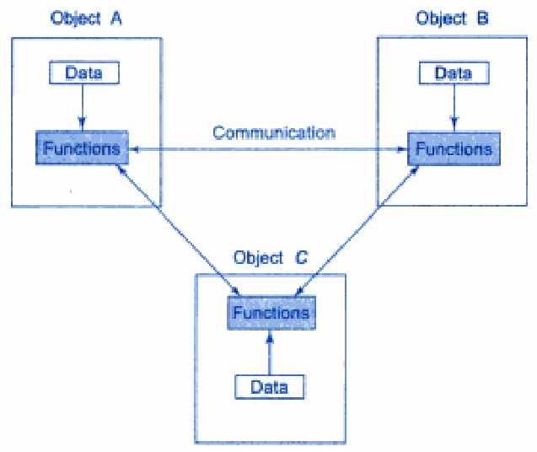
Object Oriented Programming
Object Oriented Programming is an approach that provides a way of modularizing programs by creating partitioned memory area for both data and functions that can be used as templates for creating copies of such modules on demand.

Slide 11
The Key Software Trend:
Object Technology
Objects
  Reusable software components that model items in the real world
  Meaningful software units
    Date objects, time objects, paycheck objects, invoice objects, audio objects, video objects, file objects, record objects, etc.
    Any noun can be represented as an object
  More understandable, better organized, and easier to maintain than procedural programming

Slide 12
Java – An Example of OOP
Developer: Oracle Corporation
Originally Developed by Sun Microsystems (James Gosling)
Originally called “Oak”
Java, May 20, 1995, Sun World
A general-purpose object-oriented language
Based on C/C++
Designed for easy Web/Internet applications
Widespread acceptance

Slide 13
Characteristics of Java
Java is simple
Java is object-oriented
Java is distributed
Java is interpreted
Java is robust
Java is secure
Java is architecture-neutral
Java is portable
Java’s performance
Java is multithreaded
Java is dynamic

Slide 14
Java is Simple?
Java has automatic memory management
    Automatically takes out the garbage
    No dangling pointers. No memory leaks.
Java simplifies pointer handling
    No explicit reference/dereference operations
    Everything is a pointer (like Lisp)
Syntax is just like C++.

Slide 15
Object-Oriented
(more pure than C++)
Everything is an object! All methods are virtual.

Slide 16
Network-Savvy
  Can access networks as easily as files.
  Many tools/libraries, run inside browsers.

Slide 17
Interpreted
Compile for a “Virtual Machine” (VM) based on bytecodes (.class file)
Have an interpreter (a simulator for the virtual machine).
“Just-in-time” compiler: translate bytecodes into machine code just before execution

Slide 18
Java is Cross-Platform?
Truth: Java programs can compile to
machine-independent bytecode
Truth: All major operating systems have Java runtime environments
  Most bundle it (Solaris, MacOS, Windows 2000, OS/2)
  Java
Source Code
Java Bytecode
JIT Compiler
or Interpreter
Compiler
(javac)
Java Bytecode
Execution
Compile Time
Run Time

Slide 19
Robust
A lot more compiler and runtime checks than C++.
(eg. impossible to overwrite memory and corrupt data, exception handling, runtime checks of casts, …)

Slide 20
Architecture-Neutral
Java executables will run on any machine!
(provided it has a Java bytecode interpreter)

Slide 21
Portable
Standard (fixed) data sizes:
    byte = 8 bits float = 32 bits
    short = 16 bits double = 64 bits
    int = 32 bit unicode characters
    long = 64 bits
Libraries: Java includes libraries for graphics, sound, etc., and these are implemented on all machines (UNIX, Windows 95, Mac…)
This means all Java programs are portable!

Slide 22
High Performance
Java runtimes interpret programs
s l o w l y . . .
However, it is possible to translate the Java bytecodes into native machine code just before a program is run.
These "just-in-time compilation" runtimes can make Java nearly as fast as C++.

Slide 23
Multi-Threaded
Several "threads" can run in parallel. Direct standard language support for multitasking.

Slide 24
Dynamic
Libraries are linked in later than in C++
(Java: at runtime, C++: at compiletime)
Installing a new version of a library automatically updates all programs!
Even load classes (=code) while running!

Slide 25
Java Class Libraries
Java contains class libraries
  Known as Java APIs (Application Programming Interfaces)
Classes
  Include methods that perform tasks
    Return information after task completion
  Used to build Java programs

Slide 26
The Java APIs
Oracle constantly adding new features and APIs
The Core Java API is now very large
Separate set of extension APIs for specific purposes
  E.g. Telephony, Web applications, Game programming

Slide 27
JDK (Java Development Kit) Versions
JDK Alpha and Beta (1995)
JDK 1.0 (January 23, 1996)
JDK 1.1 (February 19, 1997)
J2SE 1.2 (December 8, 1998)
J2SE 1.3 (May 8, 2000)
J2SE 1.4 (February 6, 2002)
J2SE 5.0 (September 30, 2004)
Java SE 6 (December 11, 2006)
Java SE 7 (July 28, 2011)
Java SE 8 (January 19, 2021)
To Check your java version:
  Type “java –version” to your command line.

Slide 28
Versions of Java
Three versions of the Java 2 Platform, targeted at different uses
  Java 2 Micro Edition (J2ME)
    Very small Java environment for smart cards, pages, phones, and set-top boxes
    Subset of the standard Java libraries aimed at limited size and processing power
  Java 2 Standard Edition (J2SE)
    The basic platform
    J2SE can be used to develop client-side standalone applications or applets.
  Java 2 Enterprise Edition (J2EE)
    For business applications, web services, mission-critical systems
    Transaction processing, databases, distribution, replication

Slide 29
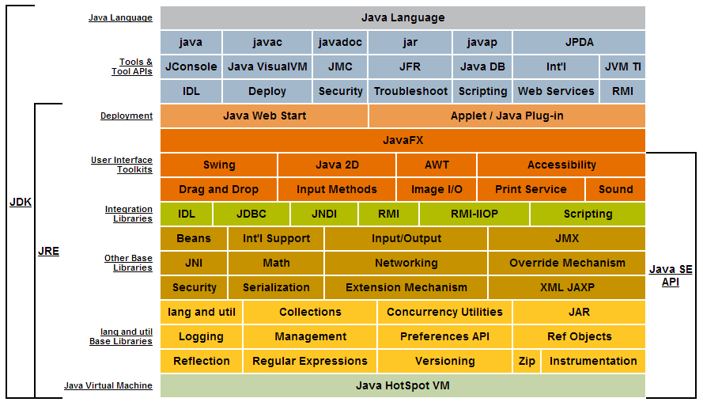
J2SE 8.0

Slide 30
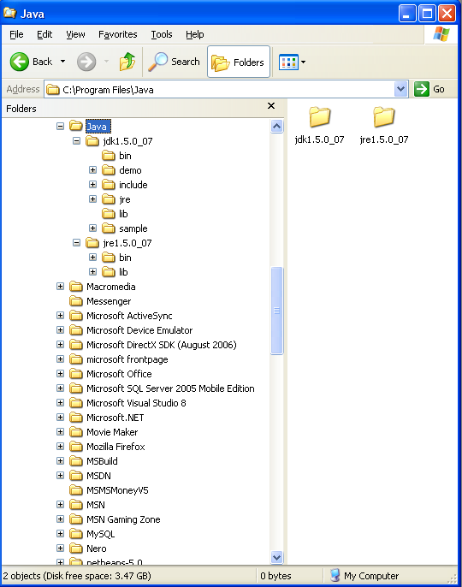
JRE and JDK
JRE: J2SE Runtime Environment
  provides
    libraries,
    Java virtual machine,
    other components necessary for you to run applets and applications
JDK: J2SE Development Kit
  includes
    JRE
    command-line development tools such as compilers and debuggers

Slide 31
JVM
JVM: Java Virtual Machines
  The Java virtual machine is an abstract computing machine that has an instruction set and manipulates memory at run time.
  The Java virtual machine is ported to different platforms to provide hardware- and operating system-independence.

Slide 32
Key Java Packages and Protocols
Core Technologies
  JDBC
  RMI
  Jini (Device Networking)
  JavaBeans
  Swing
  Java 2D
Standard Extensions
  Servlets and JavaServer Pages (JSP)
  Enterprise Java Beans
  Java 3D

Slide 33
Java Packages and Protocols:
JDBC (Java DataBase Connectivity)
API to access database
  Requires server-specific driver on client. No change to server.

Slide 34
Java Packages and Protocols:
Remote Method Invocation (RMI)
Built-in Distributed Object Protocol
  RMI lets a developer access a Java object and manipulate it in the normal manner. Behind the scenes, each function call really goes over the network to a remote object.
  restricted to Java-to-Java communication

Slide 35
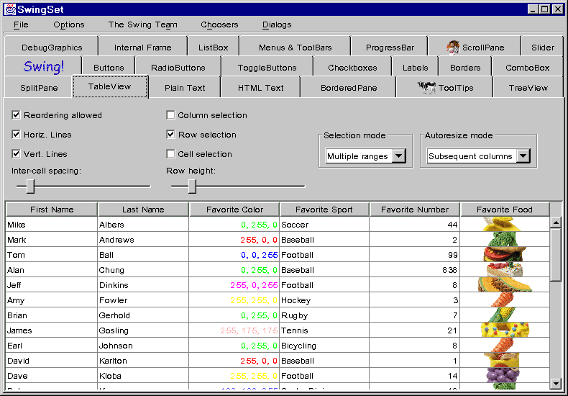
Java Packages and Protocols:
Swing
Standard GUI-control (widget) library in Java 2
Many more built-in controls
Much more flexible and customizable
Includes many small features aimed at commercial applications
  Tooltips, tabbed panes, on-line
  help, HTML support, dockable
  toolbars, multi-document
  interface, etc.
Look and feel can be
changed at run time

Slide 36
Software required:
Java Compiler:
  JDK (Java Development Kit):
    J2SE 8.2
  Download from:
    http://www.oracle.com/technetwork/java/javase/downloads/index.html
Java Editor
  JCreator 3.00 or JCreator 3.50 (simple)
  NetBeans (little bit slow, good for software development)
  JBuilder
  J#
  IntelliJ
  Eclipse
  TextPad
  BlueJ

Slide 37
Getting Started with Java Programming
A Simple Java Application
Compiling Programs
Executing Applications

Slide 38
The edit-compile-execute cycle
virtual machine
source file
class file
011010
110101
1001
10
011010
110101
010001
1
1
1
0111
0110110
compiler
(javac)
editor
(java)

Slide 39
Standard Java files
source files: *.java
Java source files contain the source code in readable form, as typed in by the programmer.
class files: *.class
Java class files contain byte code (a machine readable version of the class). They are generated by the compiler from the source file.

Slide 40
Command line invocation
compilation and execution of Java in JDK are done from a command line
On Microsoft systems: DOS shell
On Unix: Unix shell

Slide 41
First Java Program
Comments
/* My first simple Java program */
public class Hello
{
public static void main (String[] args)
{
System.out.println ("Hello World");
}
}
All Java programs have a main function;
they also start at main
Function to print to screen
What to print
Braces indicate start
and end of main
End of
statement

Slide 42
Compiling
Name of the JDK compiler: javac
To invoke:
javac <source name>
compiles <source name> and all classes it depends on
Example:
cd C:\example
javac Hello.java

Slide 43
Execution
C:\example> java Hello
“java” starts the Java virtual machine
Wrong! > java Hello.class
The named class is loaded and execution is started
Other classes are loaded as needed
Only possible if class has been compiled

Slide 44
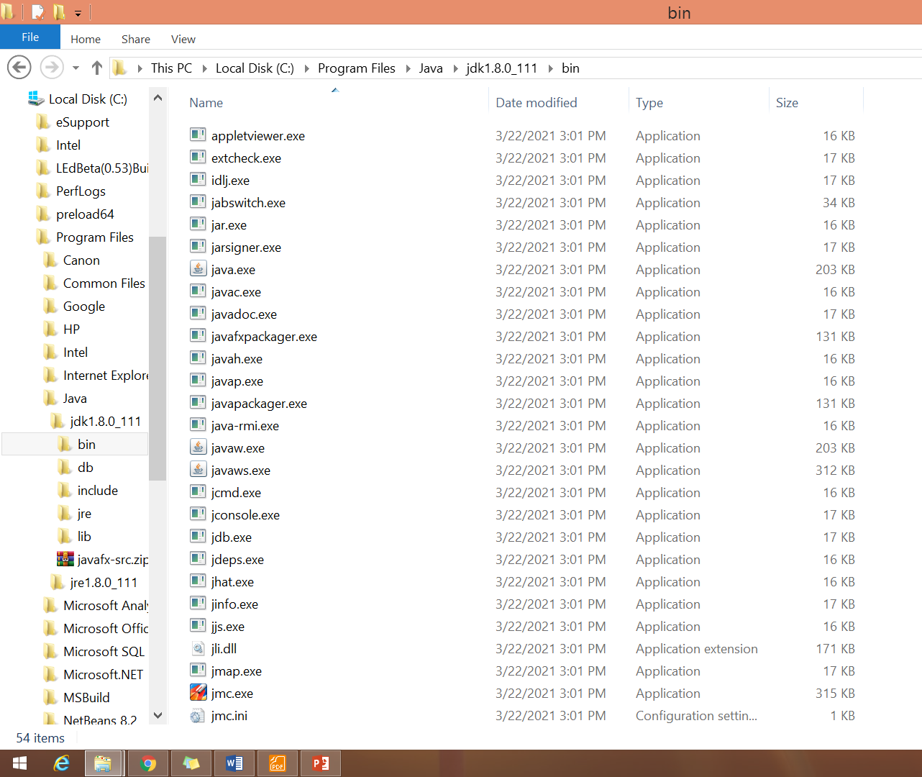

Java/jdk1.8.0_111/bin

Slide 45
Problems on compiling:
Compile the program:
  compile Hello.java by using the following command:
  javac Hello.java
  it generates a file named Hello.class
‘javac’ is not recognized as an internal or external command, operable program or hatch file.
javac: Command not found
if you see one of these errors, you have two choices:
1) specify the full path in which the javac program locates every time. For example:
C:\program files\java\jdk1.5.0_07\bin\javac Hello.java
2) set the PATH environment variable

Slide 46
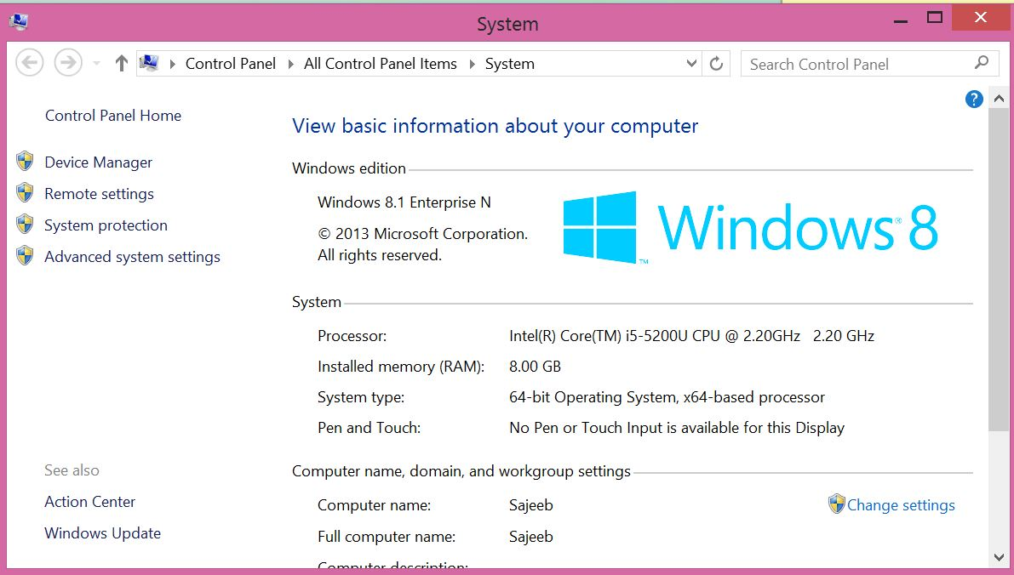
Windows Procedure to Set Path
Step 1
  Choose Control Panel-> System.
  Choose Advanced System Settings

Slide 47
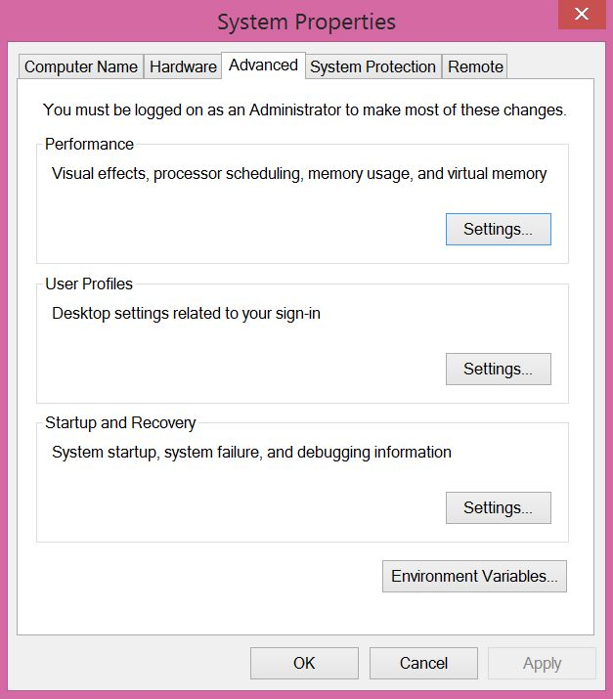
Windows Procedure to Set Path
Step 2
Choose
Environment Variables.

Slide 48
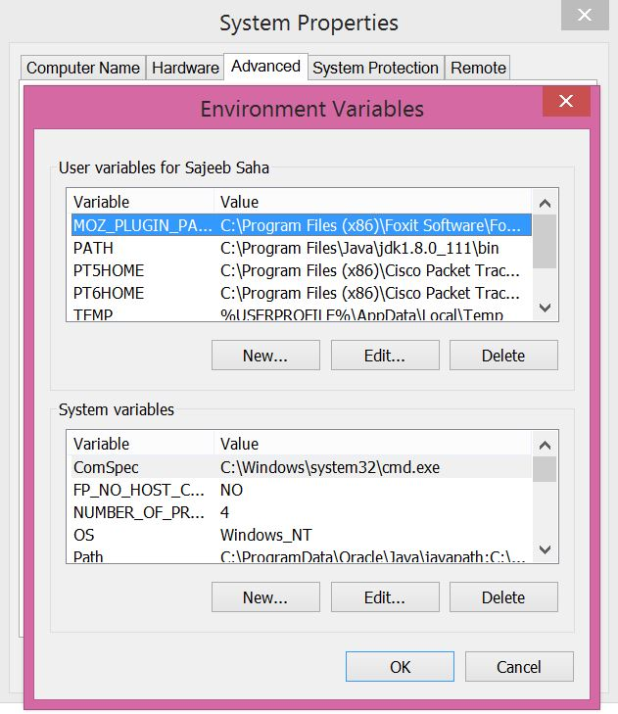
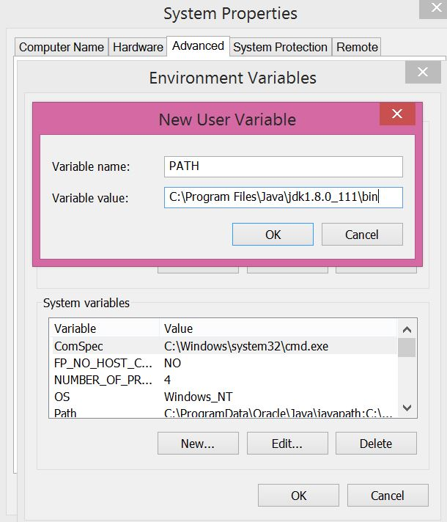
Windows Procedure to Set Path

Slide 49
Reading:
Java: The Complete Reference - Harbert Schildt
  Chapter 1

Slide 50
Homework:
Write a program that writes the following to the screen:
  Your Name
  Your Roll
  Your Email address
Find the difference between System.out.println, System.out.print
What would be the result for the following:
  System.out.printf("%s\n%10s\n%-10s\n","Hello","Hello","Hello");
Try to print an double variable in various format using printf and println function:
  (to declare double variable you can use: double abc=10.57645; )
  Various format means: exponent format, 2 digits after decimal point, 0-padded format, left justified format, right justified fomat

